Slide 1

Designing And Implementation Of Dynamic web Application Using Java
By
Tammam Awad
Reem Yaseen
Supervisor
Dr. Mohamed-Alkhateeb

Slide 2
Introduction
Driven by the explosive growth of information available on the Internet, intelligent information access has become a central research area in computer science. The 20th century is commonly characterized as “The Information Age”, and the sheer amount of information readily available today has created novel challenges. Numerous intelligent information agents software tools that provide personalized assistance for users navigating large information spaces -- have been described in the literature and deployed on the World-Wide-Web However, the need for intelligent information agents is not limited to web-based applications, as we are currently witnessing an increasing trend towards “ubiquitous information access”.

Slide 3
Objectives
Provide a clear categorization of the target system according to Customer.
Provide a fully functional system analysis of the target system
Provide an adequate explanation of the implemented techniques used to achieve the final system.
Provide a overlook of web service using JAX-RPC.
Provide a overlook of web client using JSP .
Provide a overlook of ADF.
Provide a overlook of mobile client using j2me.

Slide 4
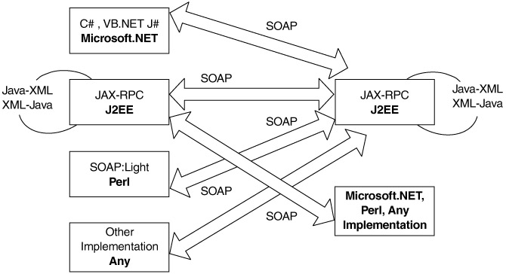
JAX-RPC

Slide 5
Servlet And JSP
The servlet technology is the foundation of web application development using the Java programming language. It is one of the most important Java technologies, and it is the underlying technology for another popular Java technology for web application development: JavaServer Pages (JSP)

Slide 6
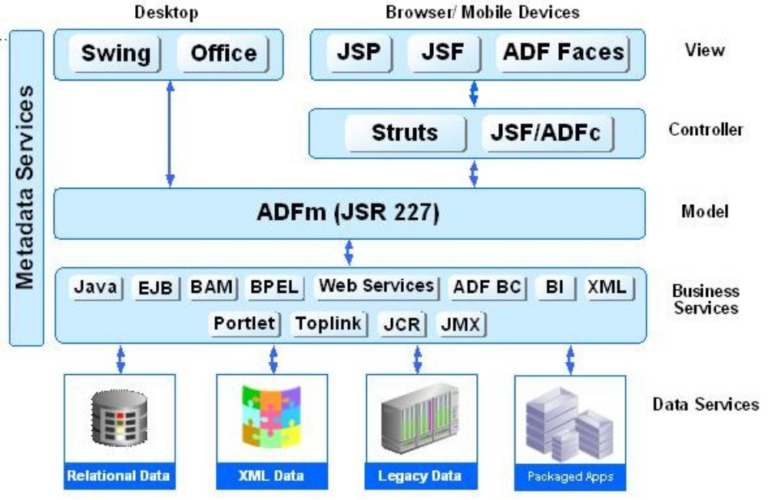
ORACLE ADF ARCHITECTURE

Slide 7
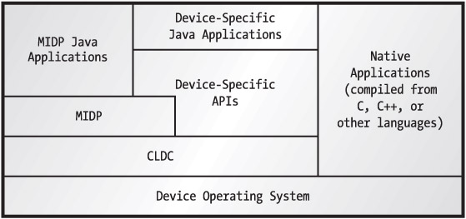
J2ME Mobile Client

Slide 8
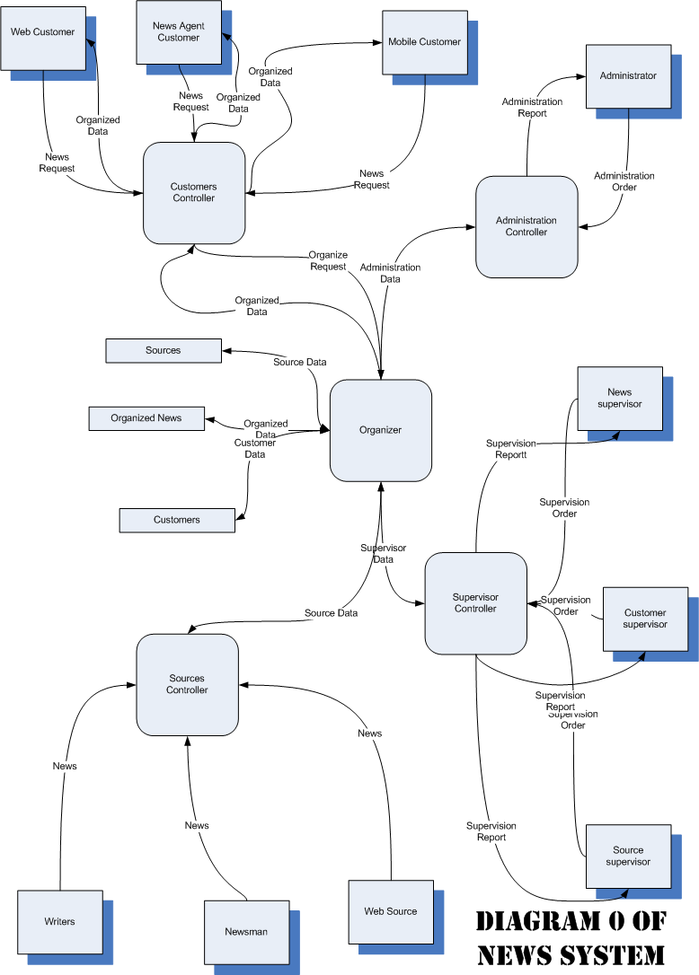

Slide 9
